Slide 1
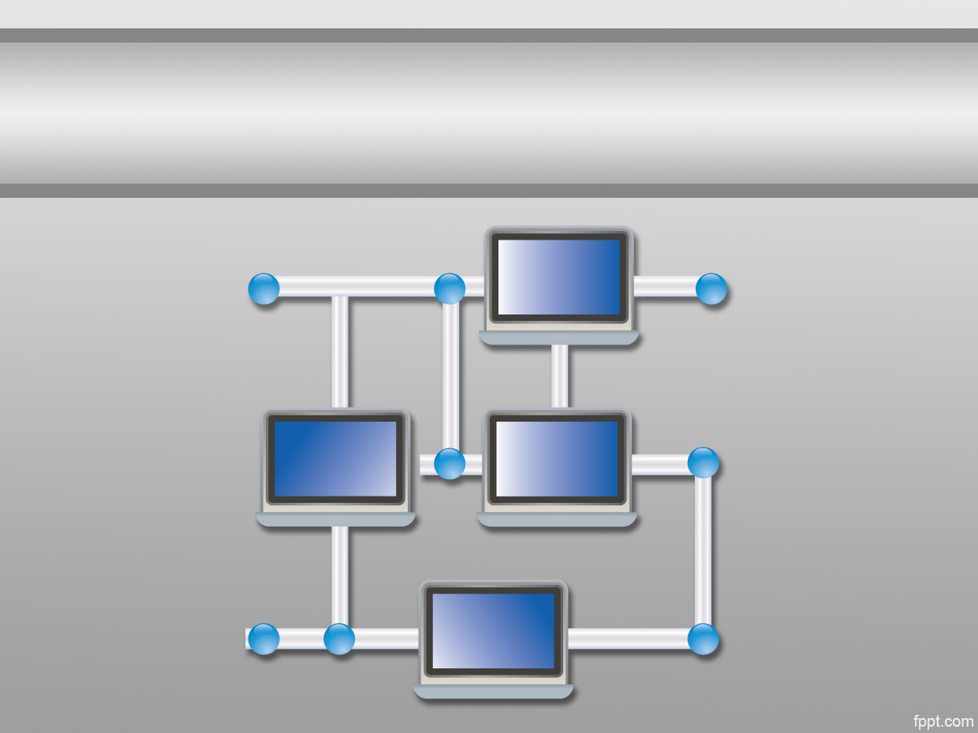
Computer Networks – Introduction lecture -1-

Slide 2
Computer Networks
A computer network is a group of interconnected computers to share data resources (printer, data folder, Internet connection,…etc).
Networks may be classified according to a wide variety of characteristics.

Slide 3
Computer Network Classifications
1. According to scale:
Local Area Network (LAN):
is a computer network covering a small physical area, like a home, office, or small group of buildings, such as a school, or an airport.
Metropolitan Area Network (MAN):
is large computer networks usually spanning a city. They typically use wireless infrastructure or Optical fiber connections to link their sites.
Wide Area Network (WAN):
is a computer network that covers a broad area (i.e., any network whose communications links cross metropolitan, regional, or national boundaries).

Slide 4
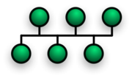
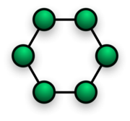

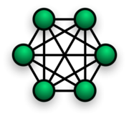
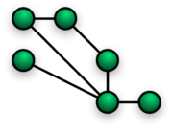
Computer Network Classifications
2. According Network topology:
Bus Network:
Ring Network:
Star Network:
Mesh Network:
Notes:
Carrier Sense Multiple Access / Collision Detection, a set of rules determining how network devices respond when two devices attempt to use a data channel simultaneously.

Slide 5
Computer Network Classifications
2. According Network topology:
Bus Network:
A single cable, the backbone functions as a shared communication medium that devices attach or tap into with an interface connector.
A device wanting to communicate with another device on the network sends a broadcast message onto the wire that all other devices see, but only the intended recipient actually accepts and processes the message.
Notes:
Carrier Sense Multiple Access / Collision Detection, a set of rules determining how network devices respond when two devices attempt to use a data channel simultaneously.

Slide 6
Computer Network Classifications
2. According Network topology:
Ring Network:
every device has exactly two neighbors for communication purposes.
All messages travel through a ring in the same direction (either "clockwise" or "counterclockwise"). A failure in any cable or device breaks the loop and can take down the entire network.
Notes:
Carrier Sense Multiple Access / Collision Detection, a set of rules determining how network devices respond when two devices attempt to use a data channel simultaneously.

Slide 7
Computer Network Classifications
2. According Network topology:
Star Network:
A star network features a central connection point called a "hub node" that may be a network hub, switch or router.
Notes:
Carrier Sense Multiple Access / Collision Detection, a set of rules determining how network devices respond when two devices attempt to use a data channel simultaneously.

Slide 8
Computer Network Classifications
2. According Network topology:
Mesh Network:
Mesh topology introduces the concept of routes.
messages sent on a mesh network can take any of several possible paths from source to destination.
A mesh network in which every device connects to every other is called a full mesh.
Notes:
Carrier Sense Multiple Access / Collision Detection, a set of rules determining how network devices respond when two devices attempt to use a data channel simultaneously.

Slide 9
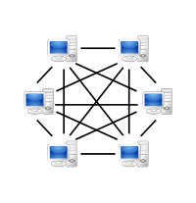
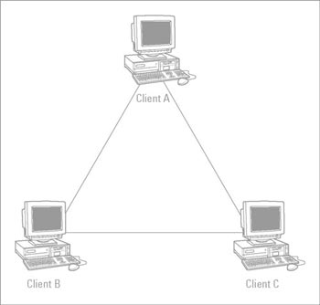
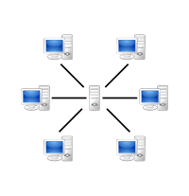
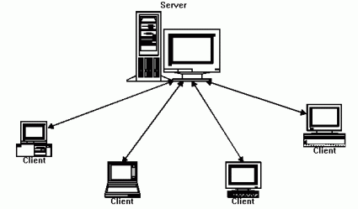
Computer Network Classifications
3. According to Functional relationship (network architecture):
peer-to-peer architecture:
client-server architecture :

Slide 10
Protocol “layers”
Networks are complex,
with many “pieces”:
hosts
routers
links of various media
applications
protocols
hardware, software
protocols define format, order of messages sent and received among network entities, and actions taken on message transmission, receipt

Slide 11
Network layers
Why do we require Layered architecture?
Divide-and-conquer approach
Easy to modify
Easy to test

Slide 12
OSI Model
The OSI Model
Open Systems Interconnection (OSI) consists of seven separate but related layers.
The purpose of the OSI model is to show how to facilitate communication between different systems without requiring changes to the logic of the underlying hardware and software.

Slide 13
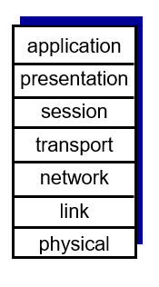
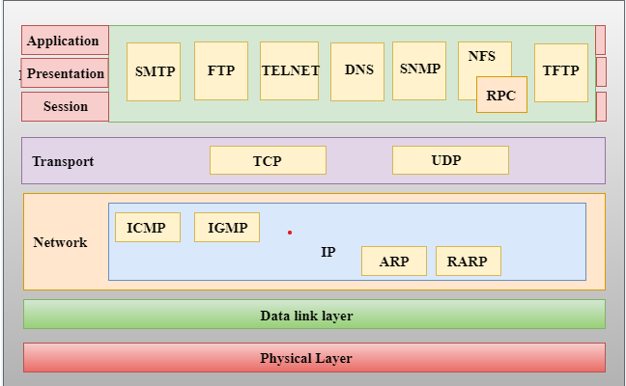
Internet protocol stack
OSI Model
TCP/IP

Slide 14
Internet protocol stack
application: supporting network applications
FTP, SMTP, HTTP
transport: process-process data transfer
TCP, UDP
network: routing of datagrams from source to destination
IP, routing protocols
link: data transfer between neighboring network elements
physical: bits “on the wire”
application
transport
network
link
physical

Slide 15
ISO/OSI reference model
presentation: allow applications to interpret meaning of data, e.g., encryption, compression, machine-specific conventions
session: synchronization, checkpointing, recovery of data exchange
application
presentation
session
transport
network
link
physical

Slide 16

source
message
M
application
transport
network
link
physical
segment
H_{t}
M
H_{t}
datagram
H_{n}
H_{n}
H_{t}
M
frame
H_{l}
H_{n}
H_{t}
M
link
physical
switch
destination
H_{n}
H_{t}
M
network
link
physical
M
application
transport
network
link
physical
H_{l}
H_{n}
H_{t}
M
H_{n}
H_{t}
M
H_{t}
M
H_{n}
H_{t}
M
H_{l}
H_{n}
H_{t}
M
router

Slide 17
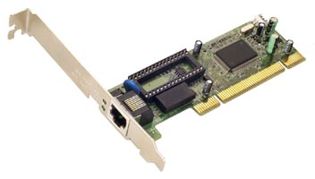
Network Interface Card
Definition :
Is a piece of computer hardware designed to allow computers to communicate over a computer network.
It provides physical access to a networking medium .
provides a low-level addressing system through the use of MAC addresses.
Each NIC has unique address consist of 48 bits.

Slide 18
Network Interface Card
MAC address:
The hardware address is also known as the Medium Access Control (MAC) address in reference to the IEEE 802.x series of standards that define Ethernet.
Each computer network interface card is allocated a globally unique 6 byte address when the factory manufactures the card (stored in a PROM).
This is the normal source address used by an interface.
A computer sends all packets which it creates with its own hardware source address, and receives all packets which match its hardware address or the broadcast address

Slide 19
Network Interface Card
Functions :
Processing of data to be sent across the network .
Send data over the network .
Control the flow of data sent between your computer and connection media.
Translation of electrical signals sent from the cable network to digital signals understood by computers and the opposite case.

Slide 20
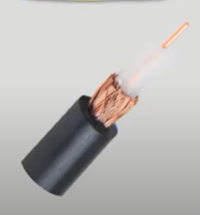
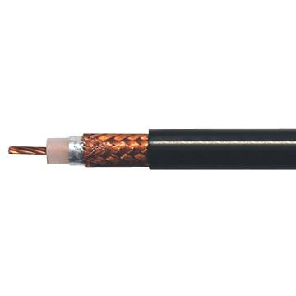
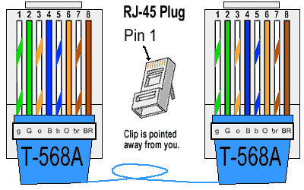
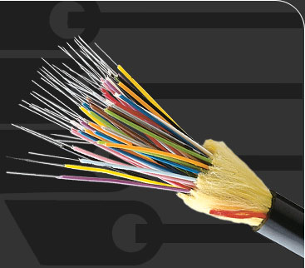
Network Connection Media
Cabling connection:
Coaxial
Twisted Pairs
Shielded Twisted Pairs (STP)
Unshielded Twisted Pairs (UTP)
Fiber optic
Greater Bandwidth
Faster speed
Longer distances
Wireless connection

Slide 21
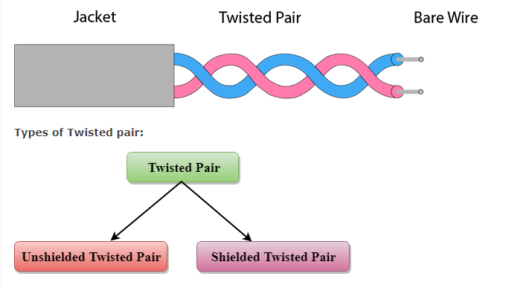
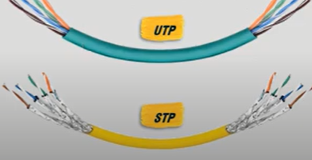
Twisted Pairs

Slide 22
Twisted Pairs
Unshielded Twisted Pair
It is cheap.
It can be used for high-speed LAN.
But this cable can only be used for shorter distances because of attenuation.
Shielded Twisted Pair
The cost of the shielded twisted pair cable is not very high and not very low.
It is shielded that provides the higher data transmission rate.
It is more expensive as compared to UTP and coaxial cable.

Slide 23
Types of Messages
(Broadcast , Unicast , Multicast )
Unicast is the term used to describe communication where a piece of information is sent from one point to another point. In this case there is just one sender, and one receiver.
If some device needs to send a message to multiple devices, it will have to send multiple unicast messages.
each message addressed to a specific device.
So, the sender has to send a separate message to each destination device, and to do that it has to know the exact IP address of each destination device.
Remember that in unicasting, each packet is destined for only one device.

Slide 24
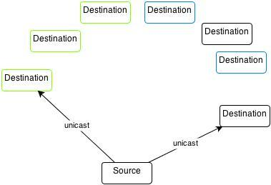
Types of Messages

Slide 25
Types of Messages
Broadcast describe communication where a piece of information is sent from one point to all other points. In this case there is just one sender, but the information is sent to all connected receivers.
The destination address in the packet is the special broadcast address.
If the packet has a broadcast address, all devices that receive that message will process it.
So, all devices on the same network segment will see the same message.
Another thing to remember is that routers don’t forward broadcast messages. The router will receive the broadcast traffic, but it will not forward it through the router.

Slide 26
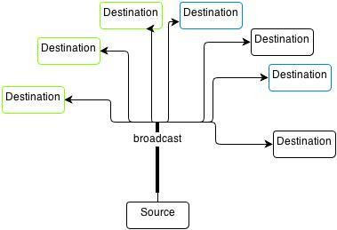
Types of Messages
Broadcast

Slide 27
Types of Messages
Multicast describe communication where a piece of information is sent from one or more points to a set of other points. In this case there is may be one or more senders, and the information is distributed to a set of receivers .
IP multicast provides dynamic many-to-many connectivity between a set of senders (at least 1) and a group of receivers.
The format of IP multicast packets is identical to that of unicast packets and is distinguished only by the use of a special class of destination address (class D IPv4 address) which denotes a specific multicast group.
Since TCP supports only the unicast mode, multicast applications must use the UDP transport protocol.

Slide 28
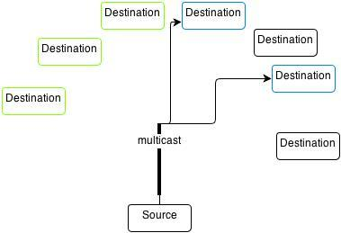
Types of Messages
Multicast

Slide 29
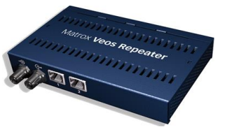
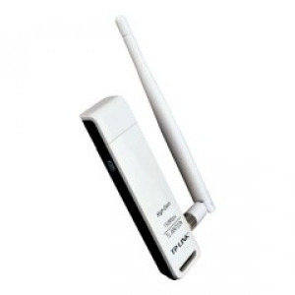
Network Devices
Hardware components :
Repeater : is an electronic device that receives a signal and retransmits it at a higher power level, to the other side of an obstruction, so that the signal can cover longer distances without degradation.
In most twisted pair Ethernet configurations, repeaters are required for cable which runs longer than 100 meters.

Slide 30
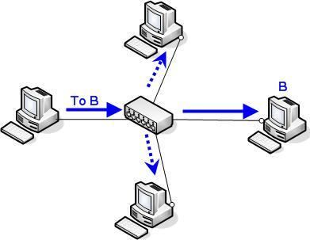
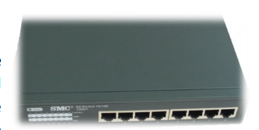
Network Devices
Hub : A network hub contains multiple ports. When a message arrives at one port, it is copied unmodified to all ports of the hub for transmission. The destination address in the frame is not changed to a broadcast address.
A device for connecting multiple Ethernet devices together and making them act as a single network segment.

Slide 31
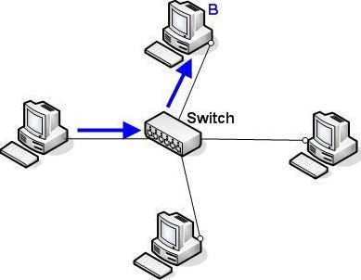
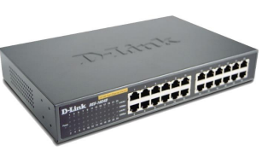
Network Devices
3. Switch:
Is a device that forwards and filters (chunk of data communication) between ports (connected cables) based on the MAC addresses in the message.
A computer networking device that is used to connect many devices together on a computer network. A switch is considered more advanced than a hub because a switch will only send a message to the device that needs or requests it, rather than broadcasting the same message out of each of its ports.

Slide 32
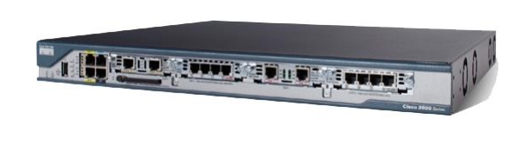
Network Devices
4. Router:
An electronic device that interconnects two or more computer networks, and selectively interchanges packets of data between them. Each data packet contains address information that a router can use to determine if the source and destination are on the same network, or if the data packet must be transferred from one network to another.
Where multiple routers are used in a large collection of interconnected networks, the routers exchange information about target system addresses, so that each router can build up a table showing the preferred paths between any two systems on the interconnected networks.

Slide 33
Broadcast and Collision domains
Collision domain
A collision domain is, as the name implies, a part of a network where packet collisions can occur. A collision occurs when two devices send a packet at the same time on the shared network segment. The packets collide and both devices must send the packets again, which reduces network efficiency. Collisions are often in a hub environment, because each port on a hub is in the same collision domain. By contrast, each port on a bridge, a switch or a router is in a separate collision domain. The following example illustrates collision domains.

Slide 34
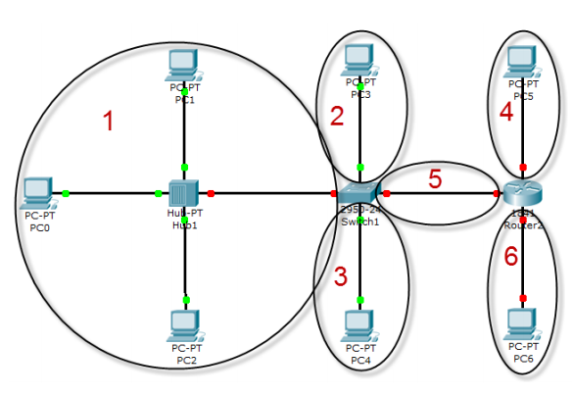
Collision domains

Slide 35
Broadcast and Collision domains
Broadcast domain
A broadcast domain is a domain in which a broadcast is forwarded. A broadcast domain contains all devices that can reach each other at the data link layer (OSI layer 2) by using broadcast. All ports on a hub or a switch are by default in the same broadcast domain. All ports on a router are in the different broadcast domains and routers do not forward broadcasts from one broadcast domain to another. The following example clarifies the concept

Slide 36
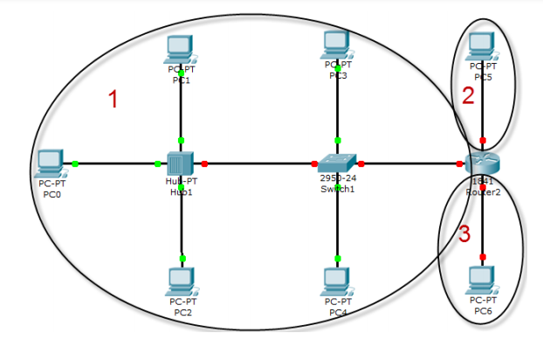
Broadcast domains

Slide 37
Transmission modes
Transmission modes
The way in which data is transmitted from one device to another device is known as transmission mode.
The transmission mode is also known as the communication mode.
The transmission mode is defined in the physical layer.
The Transmission mode is divided into three categories:
Transmission modes
Simplex mode
Half-duplex mode
Full-duplex mode

Slide 38
Basis for comparison | Simplex mode | Half-duplex mode | Full-duplex mode
Direction of communication | In simplex mode, the communication is unidirectional. | In half-duplex mode, the communication is bidirectional, but one at a time. | In full-duplex mode, the communication is bidirectional.
Send/Receive | A device can only send the data but cannot receive it or it can only receive the data but cannot send it. | Both the devices can send and receive the data, but one at a time. | Both the devices can send and receive the data simultaneously.
Performance | The performance of half-duplex mode is better than the simplex mode. | The performance of full-duplex mode is better than the half-duplex mode. | The Full-duplex mode has better performance among simplex and half-duplex mode as it doubles the utilization of the capacity of the communication channel.
Example | Examples of Simplex mode are radio, keyboard, and monitor. | Example of half-duplex is Walkie-Talkies. | Example of the Full-duplex mode is a telephone network.

Slide 39
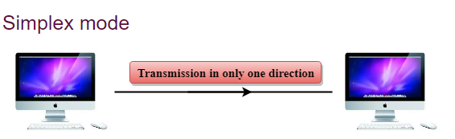
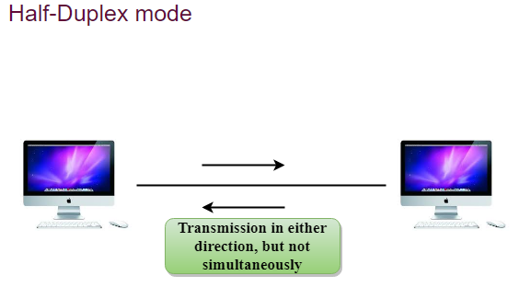
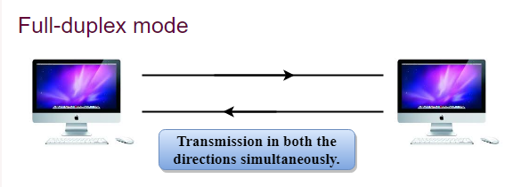

Slide 40
The End

